Slide 1
Weekly Meeting Slides
JetRacer Soccer League

Slide 2
ROS (Casey, Cooper)
Previous Work:​
Integrated NVIDIA Jetracer package
Setup keyboard tele-op publisher
Tested car's movement capabilities
Helped determine future sensor strategy
Future Work:​
Car tele-op control more reliably
Determine optimal gain/offset values
Setup Unity hooks

Slide 3
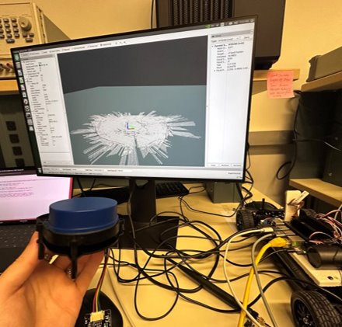
LiDAR (Arjun, Jarod)
Previous Work:
Continued to troubleshoot hector SLAM and testing feasibility without odometry
Investigated tradeoffs of rotating camera + 1D LiDAR/ultrasonic
Future Work:
Make Soccer Field to test LIDAR
Mount LiDAR on cars, test mapping in real-world
Use SLAM maps to inform navigation

Slide 4
Object Recognition (K, Julie)
Previous work:
Attempted to follow object following methods from previous years, ran into several roadblocks
Car is missing Jetbot package that can only be flashed directly onto SD card
Would wipe the entire system if we did
Year 1 managed to get it working with Darknet, but it only works with their YoloV4 model which we do not have
Looked into converting our model into Darknet format but could not find anything about it
New plan: Implement object following from scratch
Find x offset of ball from center of FOV, pass to ROS and control servos to reduce offset to 0 through PID
Future work:
Work on object tracking metric
Coordinate with ROS team to use it to steer the car towards an object
Test ball following then use similar metric to get ball displacement from goal

Slide 5
Unity (Mason)
Previous work:
Optimized the simulation further, start looking to the movement parameter of the machine learning agents, the goal is to simulate the cars movement IRL as realistic as possible.
Future work:
Create a 3rd year repo for the JetRacer github page for the sake of progress tracking.
Improve the machine learning agent model so that they have a realistic collision model.
Continue to improve the movement of the simulated cars and the integration of the environment using the SDK.

Slide 6
Questions
Using rotating camera vs. front and back camera to get "360" view
Using ultrasonic sensor or 1D LiDAR on front of car to find distance to ball
Could we use the size of the ball in the camera's FOV to find distance?
Is there a need for 2D LiDAR?
Do we need to know the position of the car relative to the field?
Does the field need to occlude the camera from seeing the external environment?

